Slide 1


SAP UI5 & FIORI with OData TRAINING using BAS
Anubhav Oberoy
Day – 3

Slide 2

Agenda – Day 3
How to Apply JS to HTML Page
Inline and Internal JS
Changing CSS at runtime
Adding Dynamic Content
Debugging
Synchronous and Asynchronous Response
External JS
What is NodeJS?
NPM – Node Package Manager
Creating a Simple node project
Creating basic function in Node JS
Creating Reusable modules
Reading files in NodeJS using the fs module
Steps to Create a Fresh Node Project
Serving our files using express module
Serving an application using Node JS

Slide 3

What is JavaScript?
JavaScript is the Programming Language for the Web. Simply, JavaScript is browser’s programming language.
Every browser directly understand JavaScript.
Java and Java Script are completely different in their design, purpose and usage.
JavaScript is the world's most popular programming language.
JavaScript is among the most powerful and flexible programming languages of the web. It powers the dynamic behavior on most websites.
There are two types of JavaScript:
Client-Side JS
Server-Side JS
Client-Side JS:
When the JS code runs on the client side (browser), then it is known as Client-side JS.
It is simple, easy and used in web development.
Since the code runs on client side, it is extremely fast and we can test/debug it directly in browser.
Server-side JS:
When the JS code runs on the server side, then it is known as Server Side JS.
This gives a benefit to developer to learn only one language with which they can code on both side.
Server side JS can be used to validate data, db look ups, send mails, trigger integration.
NodeJS is one of the example of Server Side JS. (It is a framework developed to work on server side).

Slide 4
Basic Usage of JavaScript
JS can used to show output to user.
It is used to Validate user input.
We can change the CSS at runtime using the JavaScript.
Manipulate the DOM
Access the HTML Elements and their properties/values
Send call to server
Develop Application logic
To display dialog boxes and pop-up windows.

Slide 5
Some Important Point related to JavaScript
JavaScript is case-sensitive. E.g value and Value are not same (80% developers does case-sensitive errors)
Every statement in JS ends with semi-column (;).
The variable names and function names follow camel-case naming convention which means first letter of first word is small and next consecutive word’s first letter is caps.
Ex:-
iloveindia ➔ iLoveIndia
wearelearningJS ➔ weAreLearningJs
We can declare variable in JS without specifying any data type, based on the value assigned the data type is automatically picked, the keyword to declare variable is var.
Java script unlike other programming language is a asynchronous non-blocking i/o.
JS offers 2 built-in objects
document – the object of DOM, using this object we can access HTML elements of our page.
window – it is the object of browser window
Symbols will have special meaning
( ) - parenthesis
{ } - braces
[ ] – bracket
In JS = is an assignment operator, == and === are comparison operator, == compare only value and === compare data type and value both.
We can run JS on Console. To open Console press F12 on the browser window.

Slide 6
Variables and Data Types
Variables: Variables are containers for storing data (storing data values).
Data Types: Data types in JavaScript describe the different types or kinds of data that you will be working with and storing in variables.
JavaScript Data Types
Primitive
Non-Primitive/Reference
String
Array
Object
Number
Boolean
Undefined
Null
Symbol

Slide 7
Arrays and Objects in JS
Array
An Array is a collection of data and a data structure that is stored in a sequence of memory locations.
One can access the elements of an array by calling the index number such as 0, 1, 2, 3, …, etc.
Index in an array always starts with ‘0’ (zero).
The array can store data types like Integer, Float, String, and Boolean all the primitive data types can be stored in an array.
Syntax to define an array
var arrName = [item0, item1,….];
Object
An Object is a non-primitive, structured data type in JavaScript.
Objects are same as variables in JavaScript, the only difference is that an object holds multiple values in terms of properties and methods.
Syntax to define an Object
var oObjName = { “prop”: value,
“prop”: value,
“prop”: value }
Note:
JSON stands for Java Script Object Notation.
We can validate JSON over jsonlint https://jsonlint.com
Ex:
var myArr = [1, 2, 3, 4, 5];
var myArr2 = [‘a’, ‘b’, ‘c’];
Example of an Object
{
"empStructure": {
"empNo": 100,
"empName": "Latika Roongta",
"salary": 9000,
"currency": "EUR"
}
}
Entity set
Elements or properties

Slide 8

Hands – on: JS Basics
Understand some basic coding of JavaScript in the browser Console.
Code link:
JSBasics

Slide 9
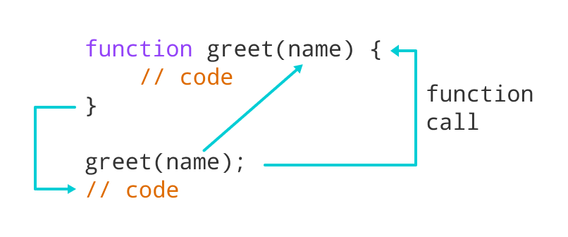
Function in JavaScript
Functions in JavaScript
A JavaScript function is a block of code designed to perform a particular task.
A JavaScript function is executed when "something" invokes it (calls it).
A JavaScript function is defined with the function keyword, followed by a name, followed by parentheses ().
The code to be executed, by the function, is placed inside curly brackets: {}
Function parameters are listed inside the parentheses () in the function definition.
Function arguments are the values received by the function when it is invoked.
Inside the function, the arguments (the parameters) behave as local variables.
Types of functions
Functions are of 2 types →
1. Anonymous function 2. Named Function
function(params) {
//code
}
function functionName(params) {
//code
}

Slide 10
How to Apply JavaScript
JavaScript can be applied to an HTML Page in three ways
Inline JS – The script code is applied at html element level using events e.g., onclick, ondblclick, onhover, onkeypress. This is not recommended as its not reusable.
Internal JS – We write script code inside a script tag. We can use functions for that. There are 2 types of function. Which means it is reusable.
External JS – JS code is written in another file which has extension as .js. We will link it with our script tag. In the same way we linked CSS with link tag.
List of JavaScript Events:
https://www.w3schools.com/jsref/dom_obj_event.asp
document: document is the object of DOM, it is used to access the DOM elements easily. It’ll provide ready to use API (functions) which are built in to access objects of DOM elements (html element).
getElementsByClassName
getElementsByTagName
getElementById

Slide 11
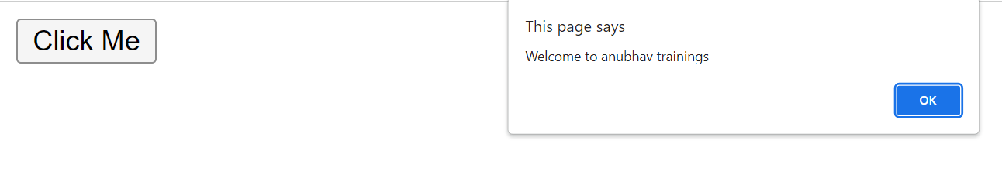
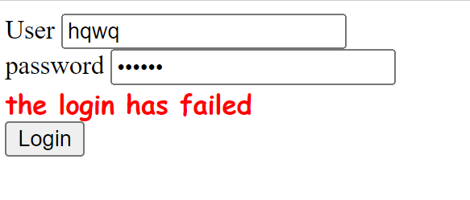
Hands – on: Inline and Internal JS
Now will apply JavaScript to our HTML page using the Inline and Internal method.
For this exercise we will create a new file named JSBasics.html in our current folder.
Part 1: Inline JS
We will create a button in the HTML page using the <button> tag and on press of that button we will show an alert message to the user.
Code Link:
JSBasics.html
Part 2: Internal JS
We will create to a form using the <label> and <input> tag in the page. It will have a username and password field. When the user enter the same value in both of the field and press the login button show success to the user else show error.
Code Link:
JSBasics.html

Slide 12
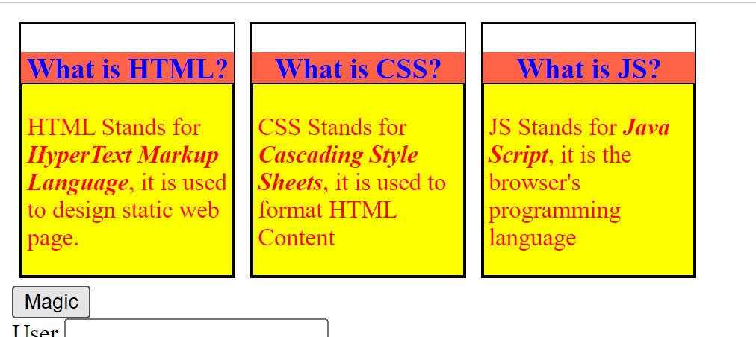
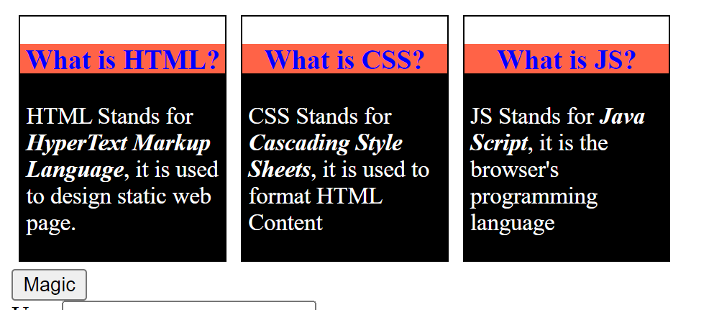
Hands – on: Changing the CSS at runtime
Now we will change the style properties of the elements in the HTML page at the runtime.
For this we will add a Magic Button on the page, on press of that we will change the color of the box-content.
Code Link:
JSBascis.html

Slide 13
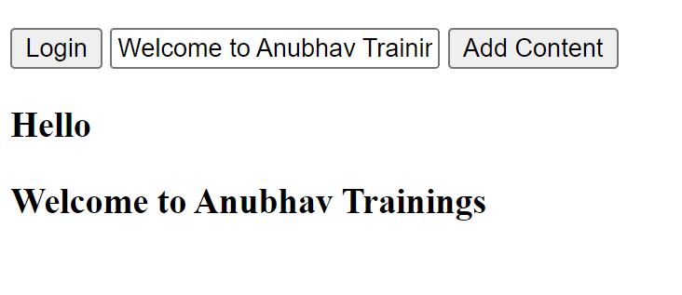
Hands – on: Adding Dynamic Content
Now we will see how to add content dynamically to our HTML page at runtime.
For this we will add a new input field and a button to the page and on press of the button whatever is written in the input field will be printed on the page.
Code Link:
JSBasics.html

Slide 14
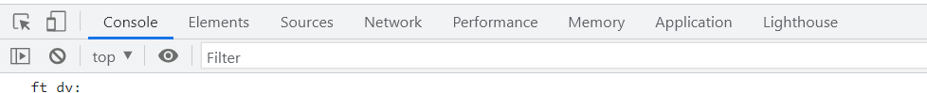
Debugging
Debugging is the process of detecting and removing of existing and potential errors (also called as 'bugs') in a software code that can cause it to behave unexpectedly or crash.
In order to debug our code, press F12 in browser window and go to the Source tab. In source tab set up the Break point by clicking on the line number.
Shortcuts for debugging are shown below:
Type | ABAP | JS
Step-in | F5 | F11
Step-out | F7 | Shift+F11
Go to next | F6 | F10
Continue (till Next BP) | F8 | F8
There are several tabs in the console, while working on the application we are mainly focused on Console, Elements, Source and Network Tab.
Console: It is the place where we run the JavaScript Code and Print the output for testing and Debugging
Elements: It shows the DOM of the current page open in browser.
Source: All the JavaScript code of the app or page will be visible here. We can also debug the code form here.
Network: We can see all the Network related calls made by the application in this section.

Slide 15
Synchronous and Asynchronous Response
User
Screen
Server
Database
Save
Processing
Time
Request send to server
Request to Database
Synchronous Response
For all this time user
Remains blocked
Response form Database
Save
Request send to server
For all this time user
Remains blocked
Request to Database
Asynchronous Response
For all this time user
Is Not Blocked
Response from the server
Response form Database
Callback

Slide 16
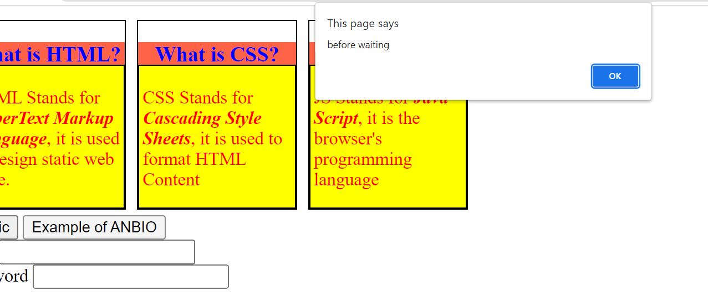
Hands – on: Async Behavior of JS
Now we will see how JavaScript works asynchronously.
We will also see how to use the Callback function in JS.
Code Link:
JSBasics.html

Slide 17
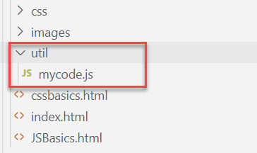
Hands – on: External JS
Create a new utils folder in the current webapp folder and in that utils folder create a new mycode.js file.
Move all the code written in the <script> tag to the new mycode.js file.
Code Link:
JSBasics.html
mycode.js

Slide 18

What is NodeJS?
Node JS is an open-source, cross platform, JavaScript runtime environment and used to execute JavaScript on Server Side.
Node JS is a framework which allows us to run JS code outside browser. The main benefit is that a development do not need to learn multiple programming languages. If we know JS, we can code both client and server side in same language.
Node JS is also a great web framework for beginners because it works great for data intensive applications like streaming, gaming and real time apps. It leverage the power of JS’s Asynchronous no blocking IO.
Application of Node JS
Build Backend Application Logic
Host a Web Server (express)
Send Emails
DB lookup
Automation
Output to the user
Use its eco-system like PDF, EXCEL, EMAIL…
Install NodeJS in our system form here https://nodejs.org/en/, if you using bas, you do not need to install as BAS already has NodeJS preinstalled.
If we want to achieve something, this something was already achieved by someone, somewhere else in the world, they have already published it as a node module which we can import and reuse. We get ready-to-use code for consumption for speedy development. https://npmjs.com

Slide 19

NPM – Node Package Manager
Node Package Manager (NPM) is a command line tool that installs, updates or uninstalls Node.js packages in your application. It is also an online repository for open-source Node.js packages. The node community around the world creates useful modules and publishes them as packages in this repository.
npm is the world's largest Software Registry.
The registry contains over 800,000 code packages.
Open-source developers use npm to share software.
Many organizations also use npm to manage private development.
npm is installed with Node.js
NPM is included with Node.js installation. After you install Node.js, verify NPM installation by writing the following command in terminal or command prompt ‘npm –v’
https://www.npmjs.com/

Slide 20
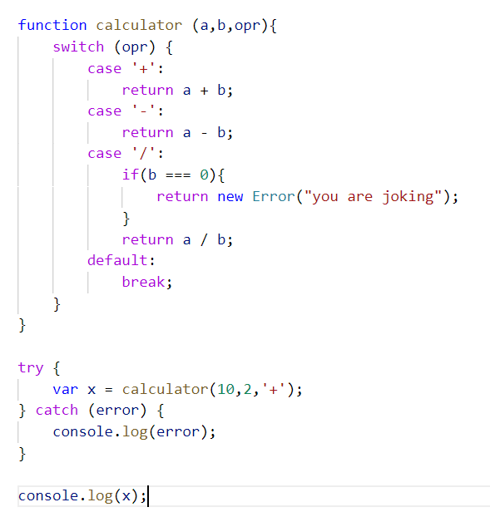
Hands – on: Basic Node Project
Create a new folder named BasicsNode and inside this folder create a new file named basicnode.js.
Now write a line in this file console.log(‘Welcome to NodeJS’);
Now to run this file open the terminal navigate to the BasicsNode folder and write command ‘node ./basicnode.js’
Now we will create a basic calculator function and will see how to use it in the NodeJS.
Code Link:
basicsnode.js

Slide 21
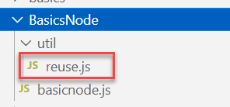
Hands – on: Creating Reusable Modules
Reusable Modules: The modules/library which can be reused at multiple place without writing the same code at multiple place.
Now we will create a reusable module (reuse.js) in our node project under the util folder in our current BasicsNode folder.
Code Link:
basicnode.js
reuse.js

Slide 22
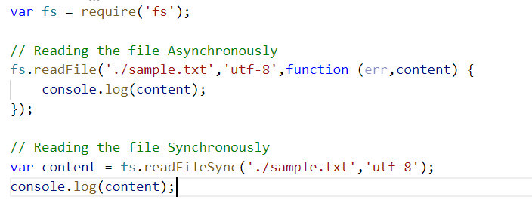
Hands – on: Using Predefined NodeJS modules
Now we will use the fs module (file system module) provided by NodeJS to read the file present in our system.
This is a predefined module which comes with NodeJS, we don’t need to install it separately.
To use this module we have to load it in our project using the require function
var fs = require(‘fs’);
We have to create a sample.txt file which we need to read.
We will see how to read the file in Synchronous and Asynchronous way in NodeJS.
Code Link:
basicnode.js
sample.txt

Slide 23
Steps to create a Fresh NodeJS Project
Run a command called npm init – Create a new Nodejs project
Answer some simple questions like project name, starring file, author, version, description, …
We can give any name to our starring file, but it is recommended to use index.js to follow the best practices.
Create the index.js file.
We can just add some code to this file. Ex: console.log(‘Welcome to anubhav trainings’);
To run the project, we can use the ‘node .’ command in the terminal.
Steps to use an external library using NodeJS
Find the library (module) of your purpose on NPM and check its documentation
To add that module/library as a dependency in our project use the command npm install moduleName
The above command we add that dependency to the package.json file.
Use require statement to use the dependency.
const obj = require(‘moduleName’);
Note:-
When we share our project with other developers then we don’t ship the node_modules with our project. The name of all the required dependencies will be there in the package.json file.
When we setup our project in a new system, we just have to run the npm install command, and it will read the package.json file and install all the dependencies.
npmjs
npm install
Laptop
Project+
Module
Laptop
Project

Slide 24
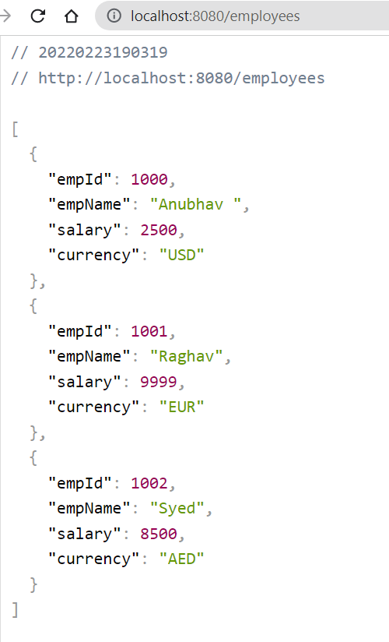
Hands – on: Start a Local Server using Express
Once our Node project is initiated, Now we need to start a local server using the Express module of NodeJS.
But first we need to add this module as a dependency. To add it run the command npm install express.
You can see the express documentation for more details: https://www.npmjs.com/package/express
We will also create local API using the NodeJS
Code Link:
index.js

Slide 25
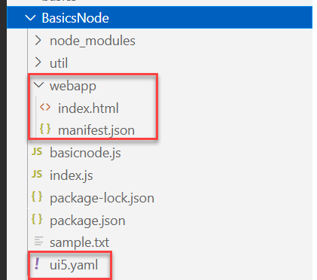
Hands – on: Starting an App using NodeJS
Now we will serve a basic html page on the local server with the help of ui5 tooling.
But before we start we have to install a few dependencies:
ui5 cli:- npm install @ui5/cli to install globally: npm install -g @ui5/cli
ux-ui5 tooling:- npm install @sap/ux-ui5-tooling to install globally: npm install –g @sap/ux-ui5-tooling
Now we have to create a webapp folder in our node project folder, and in that webapp folder create two files index.html and manifest.json.
Also create a ui5.yaml file in the project folder.
Add the required code in all the files form the links provided below.
Now to run the project use command: ui5 serve
Code Links:
index.html
manifest.json
ui5.yaml

Slide 26

End of Day 3

Slide 27

Questions

Slide 28

Anubhav Oberoy

Slide 29


We’re committed to empower you to be
Most Desirable Resource
through powerful training solutions.
We build the workforce of the future.
250+
Corporate Clients
30,000+
Learners Trained
25000+
Learners Placed
FREE WEBINARS
Sign up for free webinars with industry experts every fortnight!
Enroll Now!
Contact us today!
https://anubhavtrainings.com/

Slide 30




More from AnubhavTrainings.com

Slide 31
Title
Content

